Slide 1
I&P Acceleration FARM
Support for agricultural SMEs
I&P Acceleration FARM, supported by Proparco, is aimed at small businesses and start-ups in the agricultural sector in Sub-Saharan Africa. The programme will support around thirty companies, giving them access to financing and strategic support.
Calendar
Geography
Sector
Portfolio (target)
Sponsor
2024-2027
West Africa, Central Africa, East Africa
Agriculture, Agri-food
28 companies
Proparco (AFD Group subsidiary)
Program overview
Deployed over a period of 3 years, I&P Acceleration FARM aims to finance and support around thirty start-ups and small and medium-sized companies operating in the agricultural value chain to reduce the food crisis. The program covers 6 target countries (Cameroon, Côte d'Ivoire, Guinea, Kenya, Senegal and Uganda).
I&P Acceleration FARM has two complementary components to accelerate the development of businesses in the agricultural sector:
Seed funding
Technical Assistance
Seed funding of between €10,000 and €100,000 (between CFAF 6.5 million and CFAF 65 million) in the form of repayable advances, unsecured and interest-free.
Strategic support and capacity building through training, expert missions provided by I&P teams and external resources.
Focus: The role of SMEs in Africa's agricultural sector challenges
While Africa's population is expected to grow by 1 billion by 2050, Africa remains the continent most exposed to food insecurity.
Agricultural SMEs play a vital role in agricultural value chains: they produce 60% of the continent's food and create 70% of jobs in the agricultural and agri-food sector. The potential impact is considerable.
The main obstacle faced by these businesses is lack of access to finance: they face under-financing or access to unsuitable finance, which prevents them from realizing their potential.
In 20 years, I&P has supported 44 agri-food SMEs across the continent and invested €21.4 million, using financial mechanisms and support solutions suited to the needs of entrepreneurs.

Slide 2
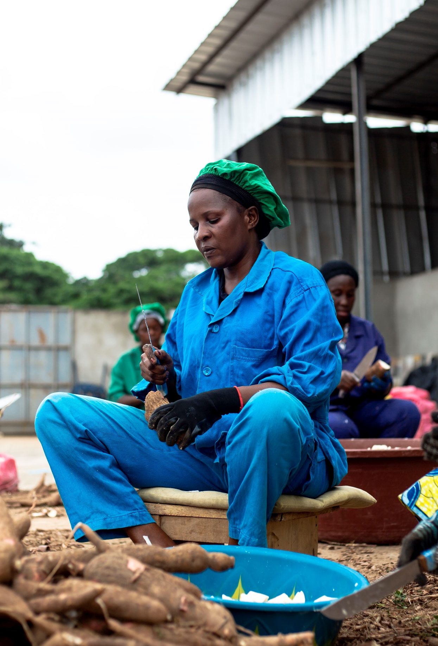
A consortium to implement the program
I&P Acceleration FARM is coordinated by Investisseurs & Partenaires (I&P), an impact investment group entirely dedicated to Sub-Saharan Africa, whose particularity is to target the ‘missing link’ in the African economic fabric, small and medium-sized enterprises and start-ups with financing needs of less than €5 million. Since its creation in 2002, I&P has supported more than 350 companies in Africa. The team is made up of more than 200 people, based in France and in 10 African offices.
For more information: www.ietp.com
The program is funded with €4 million by Proparco, a subsidiary of the Agence Française de Développement Group dedicated to the private sector.
I&P Acceleration FARM is deployed locally by I&P's network of partner investment teams, which finance and support small and medium-sized enterprises with high growth potential whose financing needs are between FCFA 6.5 million (€10,000) and FCFA 65 million (€100,000). Five partner teams are implementing the program in West, Central and East Africa: Comoé Capital in Côte d'Ivoire, Fako Capital in Cameroon, Inua Capital in Uganda, Teranga Capital in Senegal and Gola Capital in Guinea.
Eligibility criteria
I&P Acceleration FARM is based on 5 eligibility criteria:
The company must be registered in one of the 6 intervention countries (Cameroon, Côte d'Ivoire, Guinea, Kenya, Senegal, Uganda).
The company must be run by men and women working full-time on their business and wishing to collaborate with a group of investors.
The company must operate in the sectors of agricultural product processing, primary agriculture, livestock farming, fish farming and/or services linked to the agricultural sector (input distribution, training, logistics, equipment sales, market access, agritech, etc.).
The company must be committed to maximizing its positive impacts (social and/or environmental), through its activities and/or the improvement of its practices.
Particular attention is paid to projects in rural areas.
Contact us
Caty DIOKHANÉ • Program Manager • c.diokhane@ietp.com
Morgane AWU • Senior Communication Officer • m.awu@ietp.com
www.ietp.com
Investisseurs & Partenaires – I&P
@ietp.afrique
@investisseurs_et_partenaires

